Slide 1
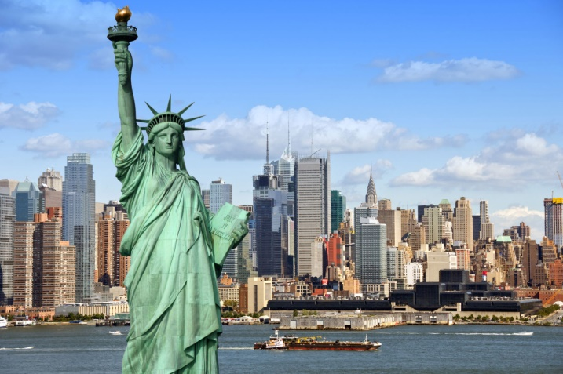
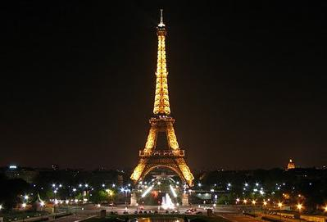
Countries and Nationalities

Slide 2
Vocabulary:
Country-страна
Nationality-национальность
Language-язык
Capital-столица
What nationality are you?-Какой вы национальности?
What language do you speak?-На каком языке вы говорите?

Slide 3
Meet Countries and Nationalities
Countries
Nationalities
America - Америка
Canada - Канада
Australia - Австралия
Italy - Италия
France - Франция
Japan - Япония
Britain – Британия
Kazakhstan-Казахстан
Russia- Россия
American – Американец
Canadian – Канадец
Australian – Австралиец
Italian - Итальянец
French – Француз
Japanese – Японец
British – Британец
Kazakh-Казах
Russian-Русский

Slide 4
Flags and Countries
Britain
France
Kazakhstan
America
Japan
Australia
Italy
Canada

Slide 5
Language:

Slide 7
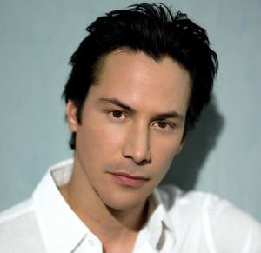
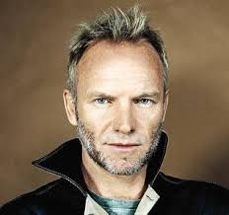
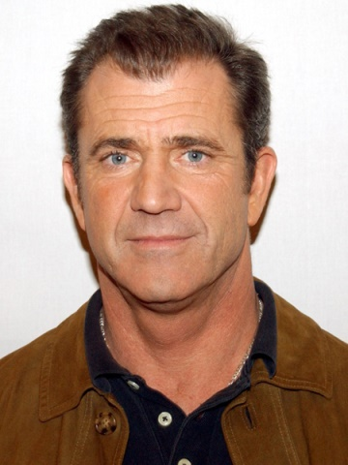
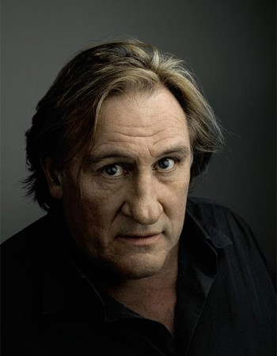
Where are they from? What Nationality are they?

Slide 8
1) Keanu Reeves is from America
He is American
2) Mel Gibson is from Australia
He is Australian
3) Sting is from Britain
He is British
4) Gerard Depardieu is from France
He is French

Slide 9
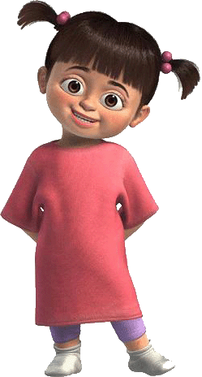
Write your story
What is her name?
How old is she?
Where is she from?
What nationality is she?
What language does she speak?

Slide 11
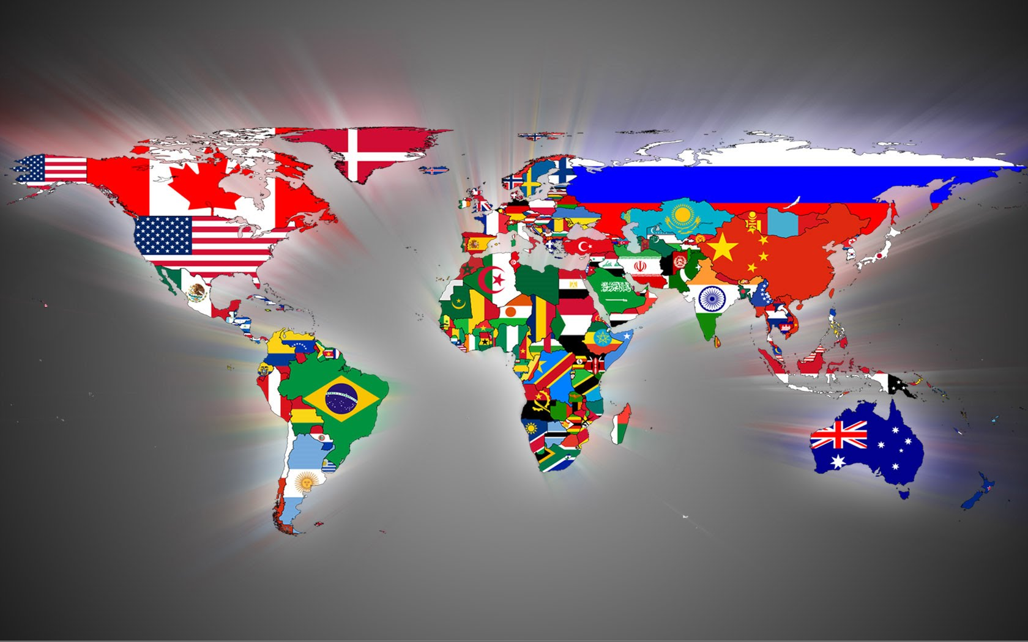
Thank you !!!

