Slide 1
Monologues and Dialogues

Slide 2
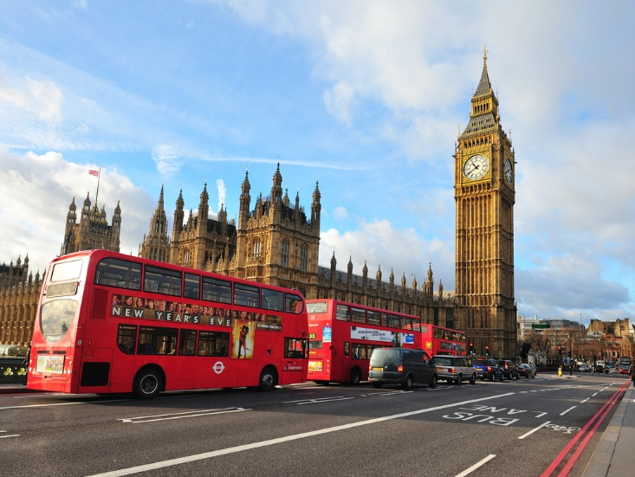
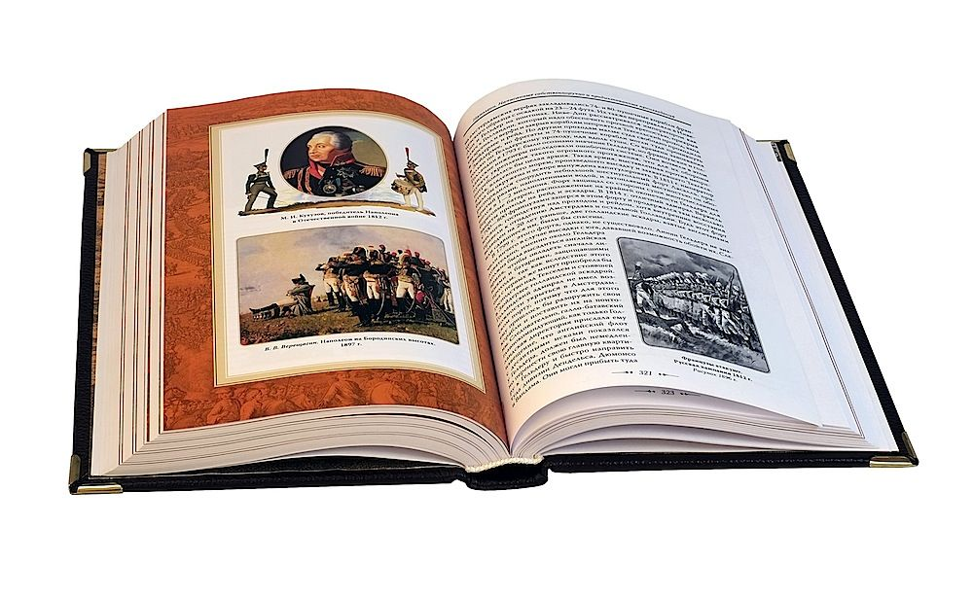

Slide 3
READ THE TEXT
My name's Rick Wilson, and I'm from London. I'm 19 years old, and I'm a student.
I go to Kingston University, I study History. I have a brother and a sister.
My brother's name is Edward. He's 16 and he's at school.
My sister's name is Rosie. She's 23, and she's married.

Slide 4
I live with my parents and my brother in a house in
West London. My father, Peter, is a salesman and my mother, Helen, is a teacher. I'm not married, but I have a girlfriend. Her name's Lily. She's lovely! My family really likes her!

Slide 5
ANSWER THE QUESTIONS
1 Has Rick any brothers or sisters?
2 Who is Rick`s father?
3 What is Rick`s girlfriend name?

Slide 6
Complete the dialogues.
a. I´m going on holiday.
b. Where __ ?
2. a. He´s cooking dinner.
b. What __ ?
3. a. My sister is going to England.
b. Who __ ?
4. a. We aren´t staying in a hotel.
b. Where __ ?

Slide 7
New vocabulary
Study- изучать, учиться
Like-нравится, любить
Keen on-увлекаться
What do you … | ?
Hobby-хобби
What is your hobby?
What do you do in your free time?
Free time-свободное время

Slide 8
Look the video
Learn English Conversation Unit 11 Hobbies - YouTube

