Slide 1
Reading
The verb “to be”

Slide 3
The verb “to be”
I am я являюсь we are мы являемся
you are ты являешься you are вы являетесь
he is он является they are они являются
she is она является
It is это является

Slide 5
Как дела?
How are you?
How are you doing?
How are you feeling?
How are you getting on?
- I`m fine, thanks (I am good, very good, very well, all right, OK, so-so ,bad, not bad)

Slide 6
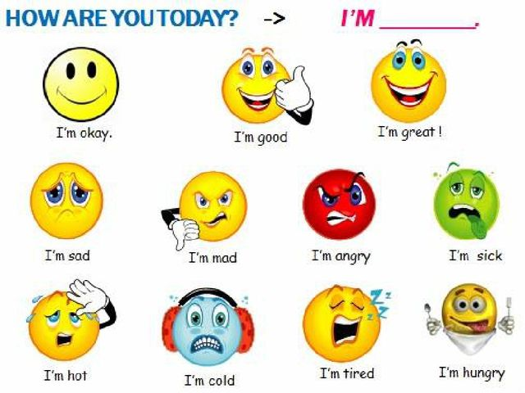

Slide 7
Look the video “How are you?”

Slide 8
What is your name? Hello
My name is …. Nice to meet you
What is your surname? See you soon
My surname is… Good bye
Where are you from? All the best
I am from Kazakhstan
How old are you?
I am 11 years old.
How are you?
I am very good, thank you.

