Slide 1
At THE SHOp
Buying the food

Slide 12
Prices. Revising big numbers.
100- one hundred
200- two hundred
1000-thousand
2000-two thousand
2550- two thousand five hundred and fifty
100 000- one hundred thousands
1 000 000- million
Euro- евро
Dollar-доллар
Tenge-тенге
Rouble-рубль
Coin-копейка

Slide 13
Countable and uncountable nouns
? - Many(много) students, pens
? – Much(много) bread, coffee, time
Few (мало) streets, flags
Little(мало) juice, butter, money
A few(немного) cards, books
A little( немного) milk, rain

Slide 14
+ some- немного, несколько
? any- немного, несколько
+ any - любой

Slide 15
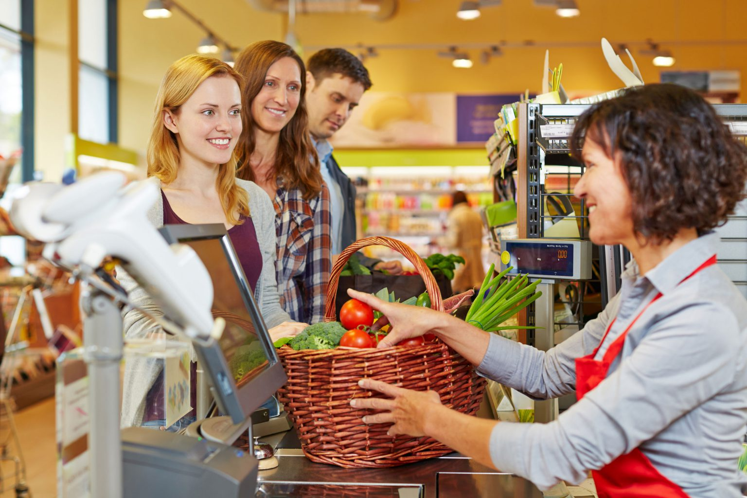
At the foods shop.

Slide 16
At the foods shop.
-Can I help you?
-Yes, please. I need 200 grams of butter, 300 grams of cheese and 400 grams of sausage.
-Here they are(вот, пожалуйста). Anything else?
-Oh, I would like to buy(мне бы хотелось) 1 packet of milk, a jar of honey, a bottle of oil.
-What kind of oil?
- Olive oil.
-Is that all?

Slide 17
- Could you give me a loaf of brown bread and 10 bottles of green tea?
-Yes, sure. Anything else?
- One more thing. I would like to buy 1 kilogram of grapes? Do you have them?
- Just a moment. I`ll check…Sorry, there are no grapes left(не осталось).
-It will cost(это будет стоить) 780 tenge. Will you pay in cash or by your card?
- In cash. Here is 800 tenge.
-Here`s 20 tenge change.
-Thank you.
- Welcome.

