Slide 1
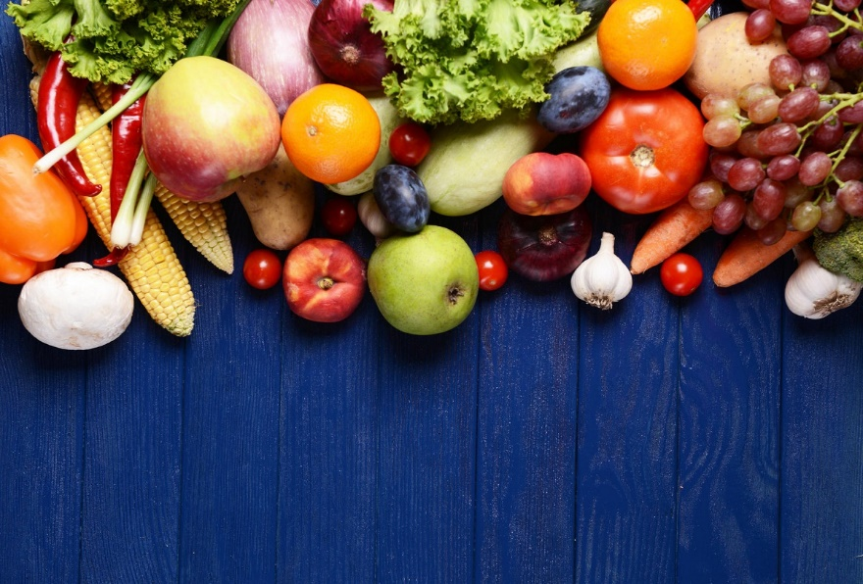
Fruit and vegetables

Slide 2
Fruit (фрукты)

Slide 3
Vegetables (овощи)

Slide 4
SAM, THE BEAR
Sam, the bear, loves fruits. He likes bananas, peaches, cherries, oranges and strawberries.
On Monday he is hungry. Sam eats 30 peaches. "Yummy, peaches are wonderful," he says.
On Tuesday he is very hungry. He eats 60 cherries, 25 strawberries and 30 bananas.

Slide 5
On Wednesday Sam eats 40 oranges. He doesn't eat peaches on Wednesday.
What does Sam eat on Thursday? Sam hates apples, but he doesn't have any bananas or peaches or strawberries. So Sam eats 25 apples on Thursday.
On Friday Sam is not hungry. Sam has a stomachache.

Slide 6
True or false?
a) Sam loves meat.
b) On Monday he eats grapes.
c) He thinks peaches are wonderful.
d) Sam eats 60 bananas.
e) Sam hates apples.

Slide 7
2. Запишите в таблице, что ел медвежонок Sam в определенный день недели.
 | Monday | Tuesday | Wednesday | Thursday | Friday
Sam

Slide 8
TRUE or False?
Apples are red.
Pineapples are brown and purple.
Grapes are purple and green.
Pears are black.
Bananas are yellow.
Cherries are brown.
Strawberries are red.
Peaches are orange.

Slide 9
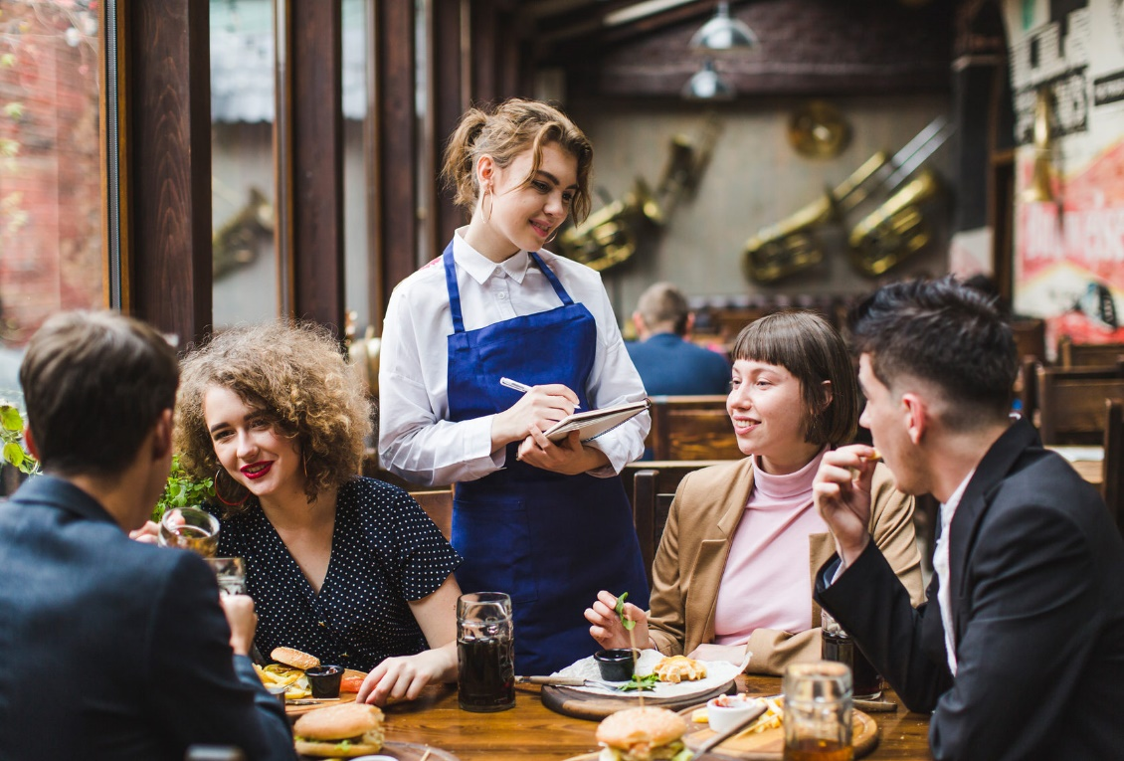
dialogue At the café
-Let`s go to the café.
-I am hungry
- I am thirsty (у меня жажда)
-I would like( мне бы хотелось) some(не много)…
-Could you show me the menu?
-Here it is. (вот, пожалуйста)

Slide 10
-Are you ready to order (заказывать)?
-Yes, we will have fish and chips.
-Anything else?
-Shall we have a drink?
-Yes, I`ll have strawberry milk shake
-And I want to drink a cup of carrot juice
- How do you like fish?

Slide 11
Oh, it`s very delicious (вкусно) (nice, tasty, good)
-What about(как на счёт десерта)the dessert?
- Here is your bill(check). That will be 1 pound 39 pence.
-Thank you
-Here is the change (сдача).

