Slide 1
Present Simple
(настоящее простое время)

Slide 2
Present Simple
(настоящее простое время)
Повествовательное предложение

Slide 3

To Be
I am a pupil
He
She
is a pupil
It
You
We
They
are pupils

Slide 4
I
You
We
They
have (got) a dog
Wow!
He
She
It
has (got) a dog

Slide 5
I
You
We
They
do
read a book
He
She
It
does
reads a book

Slide 6
Not
Not
Present Simple
Not
Not
Not
Not
Not
Отрицательное предложение

Slide 7

                To Be
I am not a pupil
He
She
It
is not a pupil
You
We
They
are not pupils

Slide 8

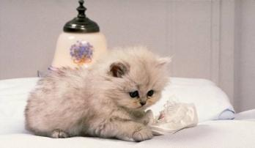
I
You
We
They
have not a cat
He
She
It
has not a cat

Slide 9
Do not = Don’t
I
You
We
They
don’t like a pie
Does not = doesn’t
He
She
It
Doesn’t like a pie

Slide 10
Present Simple
Общий вопрос

Slide 11
Is he a pupil? Yes, he is
Have you a dog? Yes, I have
Has she a cat? Yes, she has
Do you read a book? Yes, I do
Does she like an ice-cream? Yes, she does

Slide 12
Is he a pupil? She isn’t
Have you a dog? I haven’t
Has she a cat? She hasn’t
Do you read a book? No, I don’t
Does she like an ice-cream? No, she doesn’t

Slide 13
Present Simple
Who?
Вопрос к подлежащему

Slide 14
Who are you? Кто?
Who is he? Кто?
Who reads a book? Кто?
Who likes an ice-cream? Кто?

Slide 15
Present simple
What
Where
When
Специальный вопрос

Slide 16
1. What is he? What ?
Where?
2. What do you have? When?
Why?
How?
3. What does he read?
How many?
How much?
4. What do you eat?

Slide 17
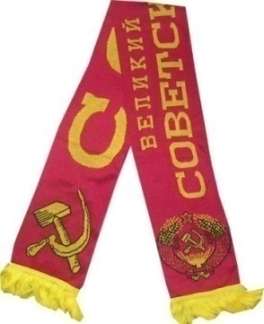
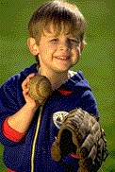
Сделай вопрос!
1. They have an English book.
- What do they have?
or
- What have they?
2. He has a red USSR scarf.
- Who has a red USSR scarf?
3. The child has many toys.
- How many toys has the child?
or
- How many toys has the child?

Slide 18

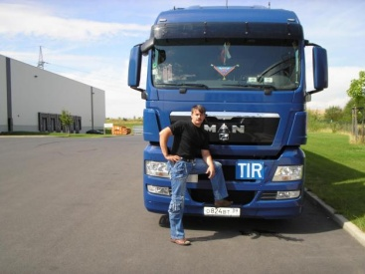

Сделай отрицательное предложение и вопросительное
1. This is a cat
- This isn’t a cat.
- Is this a cat?
2. They are drivers.
- They aren’t drivers.
- Are they drivers?
3. I am at home.
- I am not at home.
- Are you at home?

Slide 19
Поставь все типы вопросов
She gets up at 8 o’clock.
- Does she get up at 8 o’clock?
- Does she get up at 8 o’clock or at 11 o’clock?
- Who gets up at 8 o’clock?
- When does she get up?
- She gets up at 8 o’clock, doesn’t she?
- She doesn’t get up at 8 o’clock, does she?

Slide 20
Поставь все типы вопросов
They play volley-ball every Sunday
- Do they play volley-ball?
- Do they play volley-ball or basketball?
- Who plays volley-ball?
- When do they play volley-ball?
- They play volley-ball every Sunday, do they?
- They don’t play volley-ball every Sunday, do they?

