Slide 1
At the airport

Slide 2
NEW VOCABULARY
flight - рейс
check-in - регистрироваться на рейс
delayed - задержан
canceled - отменен
gate - зона выхода на посадку
luggage/baggage - багаж

Slide 3
departure - отправление
arrival - прибытие
layover - пересадка
seat - место в самолете
aisle-проход
boarding time - время посадки пассажиров
boarding pass - посадочный талон

Slide 7
one way- в одну сторону return- в обе стороны

Slide 9
Discussing.
1 How often do you go by plane somewhere?
2 What are the necessary things you always put in your hand luggage?
3 Tell about your last flight. What airline did you choose? How long was the flight? Where did you head to? Did you like the experience?

Slide 10
Look the video “Check-in”
https://www.youtube.com/watch?v=KbMBGd97EC4

Slide 11
Read the dialogue:
AT THE AIRPORT
A: Can I help you?
B: Yes, I’d like a ticket to London.
A: We have three flights a week to London : Tuesday, Friday and Sunday.
B: I need to be there on Friday

Slide 12
A: And which class do you like to fly? Economy, business or first class?
B: Business , please.
A: And will anyone traveling with you?
B: No, I am traveling along. How much will it be?
A: 440 dollars.

Slide 13
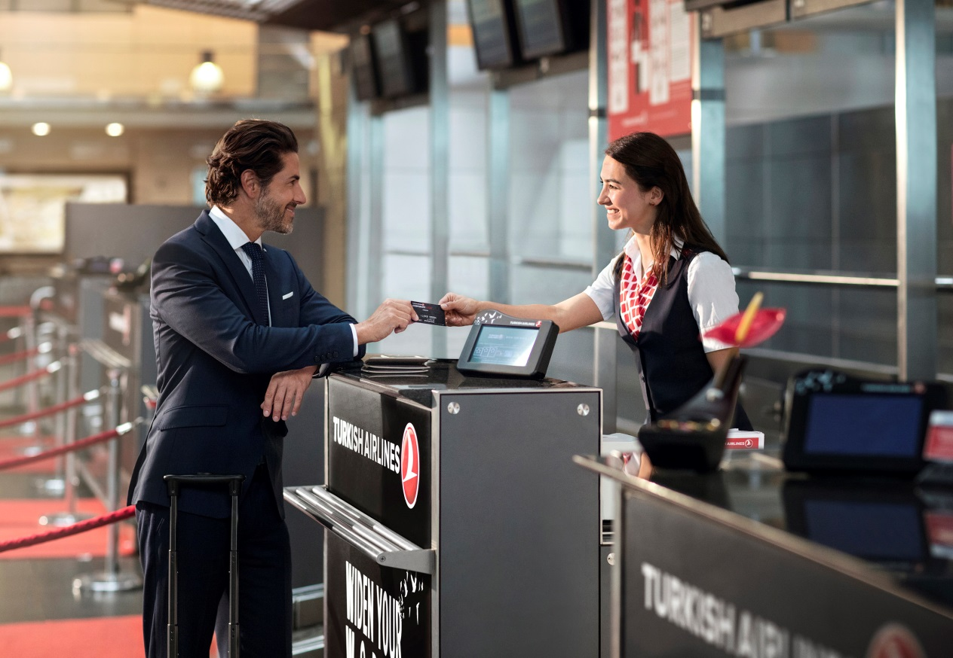
B: What’s the flying time?
A: Six hours
B: All right. Thank you.

