Slide 1
LISAKOVSK TOWN

Slide 2
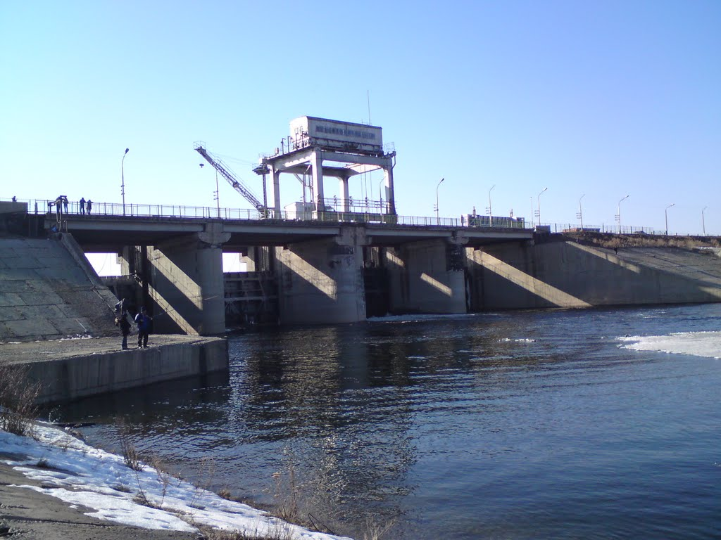
Our native town Lisakovsk is situated on the bank of the river Tobol in Kostanay region in Kazakhstan.

Slide 3
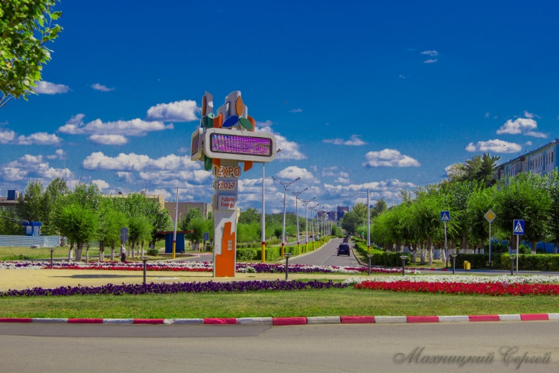
Lisakovsk is a small and modern town. The population of Lisakovsk is about 45 thousand people.

Slide 4
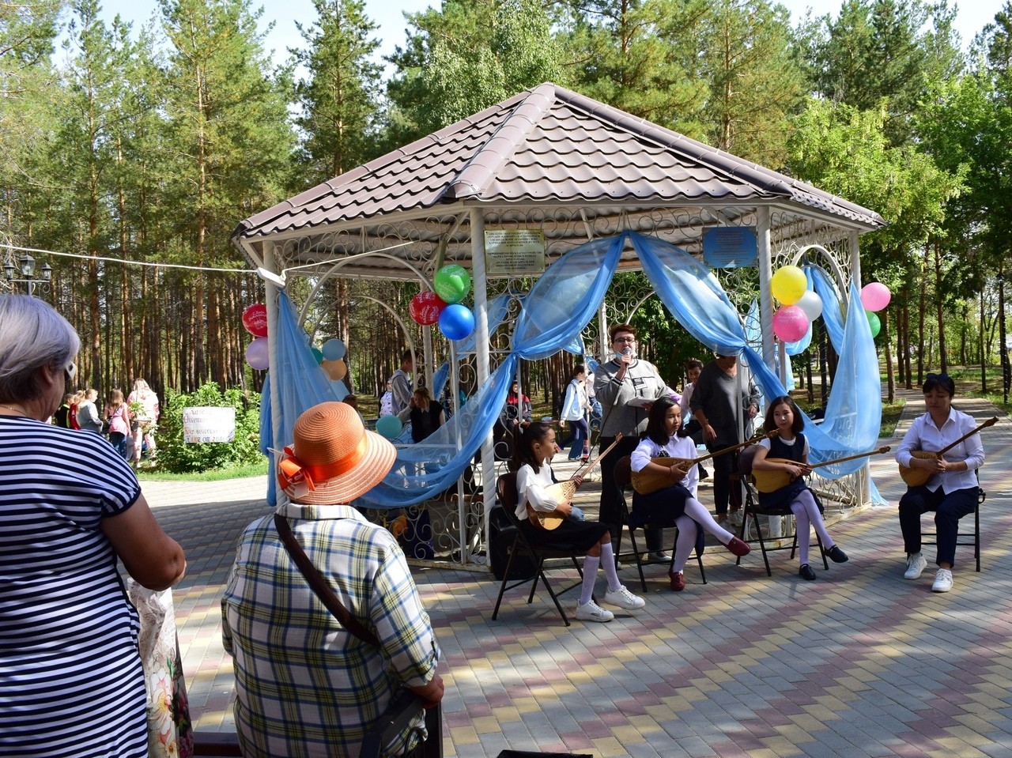
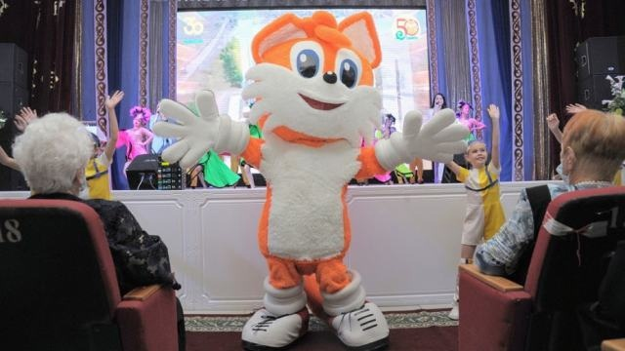
This year our hometown is 50 years old!

Slide 5
There are 6 schools in our town. The Monument to Motherland is in the Park of Victory. We have a Town museum where there are many exhibits, documents, photos devoted to the history of Lisakovsk.

Slide 6
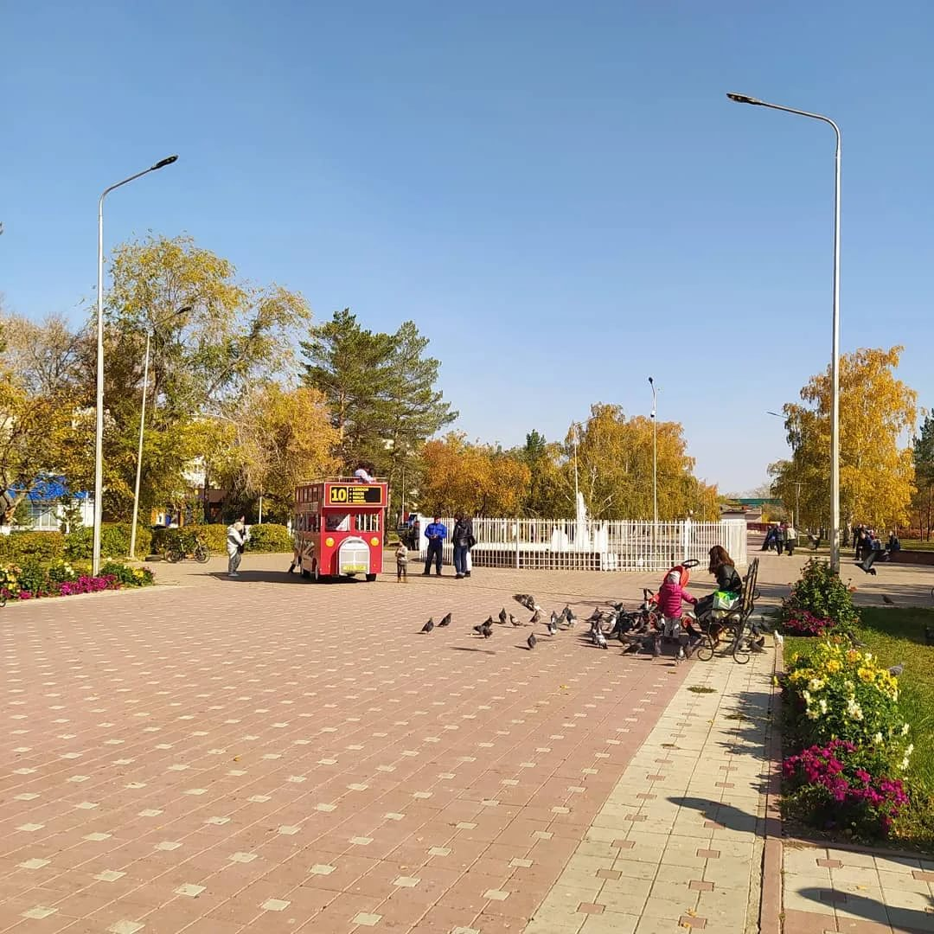
Satpayev Street is the central street. There are many shops, cafes, hotels, kindergartens in all the micro districts of the town.

Slide 7
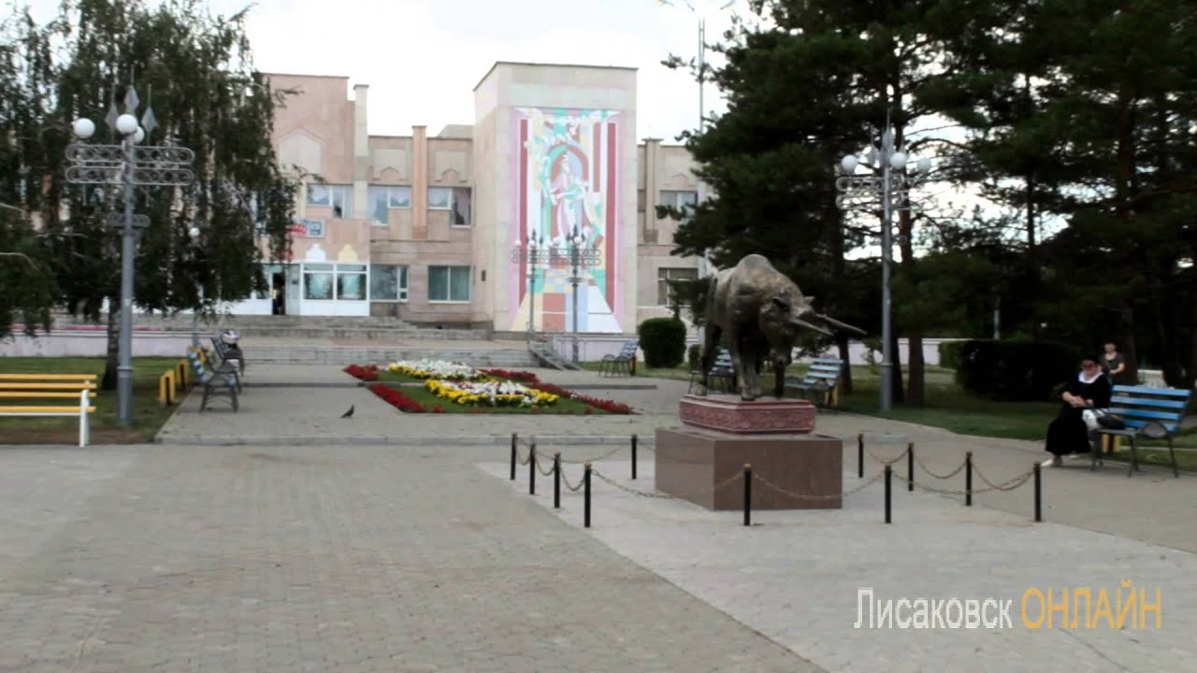
The House of Culture ``Union`` is the centre of educated and cultural life in Lisakovsk.

Slide 8
Our town is green, clean and beautiful.
We are proud of our native town and want to make it better!

Slide 9
Vocabulary:
on the bank of- на берегу
modern- современный
hometown- родной город
devoted to the history- посвященные истории
proud of- гордится

Slide 10
THANK YOU!

